Slide 1
Software Engineering
Topic 2
Software Process Model

Slide 2
Acknowledgement
These slides have been adapted from
Pressman, R.S. (2015). Software Engineering : A Practioner's Approach. 8th ed. McGraw-Hill Companies.Inc, Americas, New York. ISBN : 978 1 259 253157. Chapter 3 , 4, 5 and 6

Slide 3
LO 1 : Describe the concepts of software process models and the opportunity for potential business project
Learning Objectives

Slide 4
Contents
Software Process Structure
Process Models
Agile Development
Human Aspects of Software Engineering

Slide 5
SOFTWARE PROCESS STRUCTURE

Slide 6

Software Process Structure
Software Process Framework

Slide 7
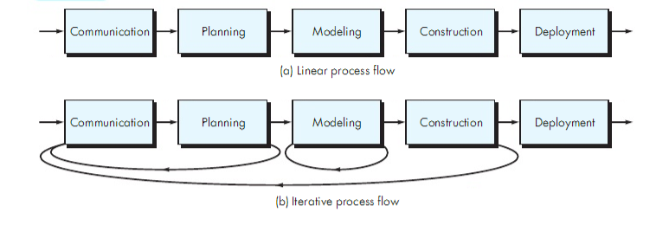
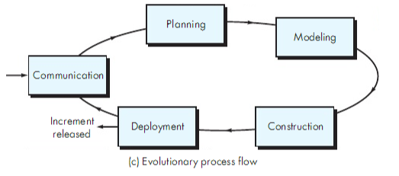
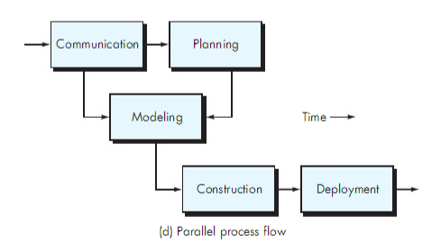
Software Process Structure
Process Flow

Slide 8
Software Process Structure
Identifying a Task Set
A task set defines the actual work to be done to accomplish the objectives of a software engineering action.
  A list of the task to be accomplished
  A list of the work products to be produced
  A list of the quality assurance filters to be applied

Slide 9
Software Process Structure
Process Patterns
A process pattern
  describes a process-related problem that is encountered during software engineering work,
  identifies the environment in which the problem has been encountered, and
  suggests one or more proven solutions to the problem.
Stated in more general terms, a process pattern provides you with a template [Amb98]—a consistent method for describing problem solutions within the context of the software process.

Slide 10
Software Process Structure
Process Pattern Types
Stage patterns—defines a problem associated with a framework activity for the process.
Task patterns—defines a problem associated with a software engineering action or work task and relevant to successful software engineering practice
Phase patterns—define the sequence of framework activities that occur with the process, even when the overall flow of activities is iterative in nature

Slide 11
PROCESS MODEL

Slide 12
Process Models
Prescriptive process models advocate an orderly approach to software engineering
That leads to a few questions …
If prescriptive process models strive for structure and order, are they inappropriate for a software world that thrives on change?
Yet, if we reject traditional process models (and the order they imply) and replace them with something less structured, do we make it impossible to achieve coordination and coherence in software work?

Slide 13
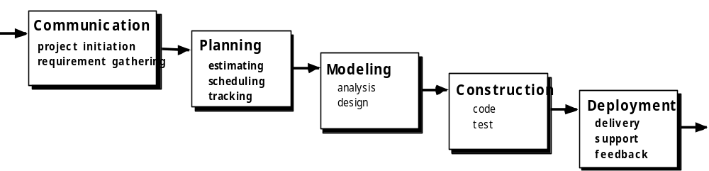
Process Models
The Waterfall Model

Slide 14

The V-Model
Process Models

Slide 15
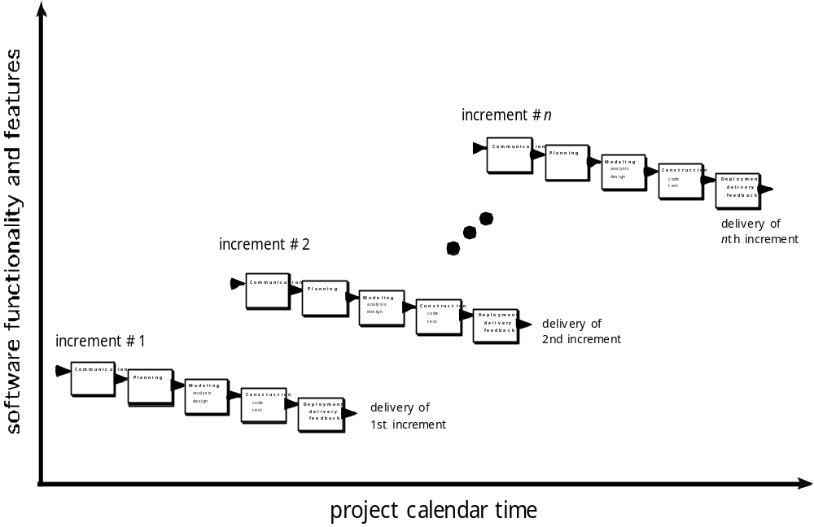
The Incremental-Model
Process Models

Slide 16

Evolutionary Models: Prototyping
Process Models
Quick
plan
communication
Modeling
Quick design
Deployment
delivery &
feedback
Construction
of prototype

Slide 17
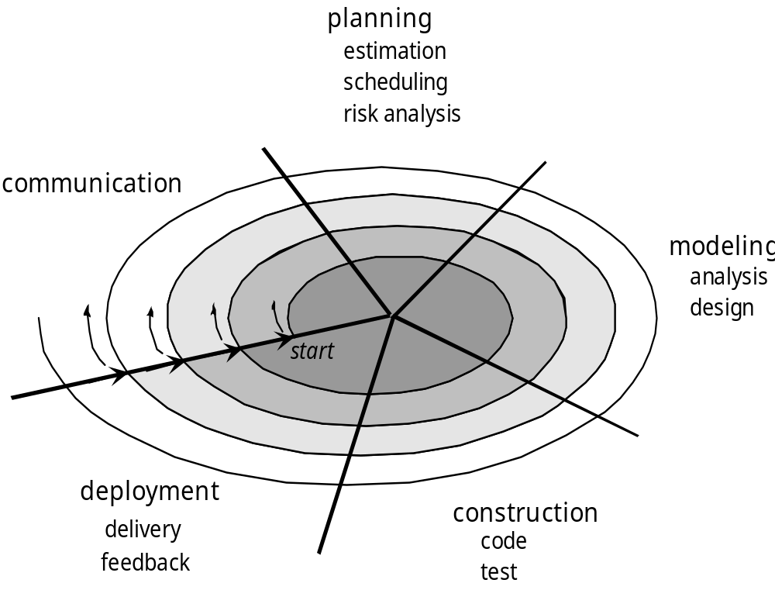
Evolutionary Models: The Spiral
Process Models

Slide 18
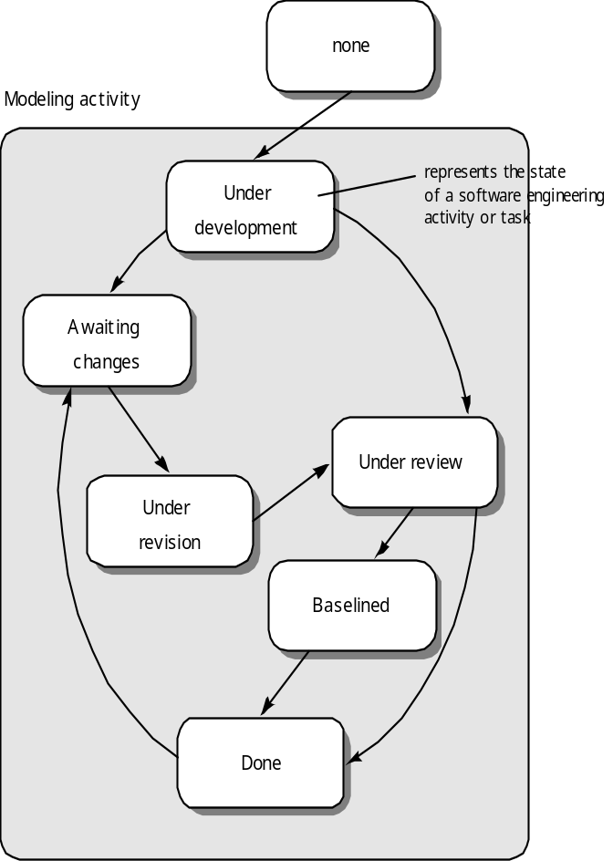
Evolutionary Models: Concurrent
Process Models

Slide 19
Specialized Process Models
Component based development—the process to apply when reuse is a development objective
Formal methods—emphasizes the mathematical specification of requirements
AOSD—provides a process and methodological approach for defining, specifying, designing, and constructing aspects
Unified Process—a “use-case driven, architecture-centric, iterative and incremental” software process closely aligned with the Unified Modeling Language (UML)

Slide 20
AGILE DEVELOPMENT

Slide 21
Manifesto for Agile Software Development
Agile Development
We are uncovering better ways of developing
software by doing it and helping others do it.
Through this work we have come to value:
Individuals and interactions over processes and tools
Working software over comprehensive documentation
Customer collaboration over contract negotiation
Responding to change over following a plan
That is, while there is value in the items on
the right, we value the items on the left more
Source: agilemanifesto.org
Notes:
New slide

Slide 22
What is “Agility”?
Agile Development
Effective (rapid and adaptive) response to change
Effective communication among all stakeholders
Drawing the customer onto the team
Organizing a team so that it is in control of the work performed
Yielding …
Rapid, incremental delivery of software

Slide 23

Agility and the Cost of Change
Agile Development

Slide 24
Extreme Programming (XP)
Agile Development
The most widely used agile process, originally proposed by Kent Beck
XP Planning
  Begins with the creation of “user stories”
  Agile team assesses each story and assigns a cost
  Stories are grouped to for a deliverable increment
  A commitment is made on delivery date
  After the first increment “project velocity” is used to help define subsequent delivery dates for other increments

Slide 25
Extreme Programming (XP)
Agile Development
XP Design
  Follows the KIS principle
  Encourage the use of CRC cards (see Chapter 8)
  For difficult design problems, suggests the creation of “spike solutions”—a design prototype
  Encourages “refactoring”—an iterative refinement of the internal program design
XP Coding
  Recommends the construction of a unit test for a store before coding commences
  Encourages “pair programming”
XP Testing
  All unit tests are executed daily
  “Acceptance tests” are defined by the customer and executed to assess customer visible functionality

Slide 26

Extreme Programming (XP)
Agile Development

Slide 27
Adaptive Software Development
Agile Development
Originally proposed by Jim Highsmith
ASD — distinguishing features
  Mission-driven planning
  Component-based focus
  Uses “time-boxing”
  Explicit consideration of risks
  Emphasizes collaboration for requirements gathering
  Emphasizes “learning” throughout the process

Slide 28
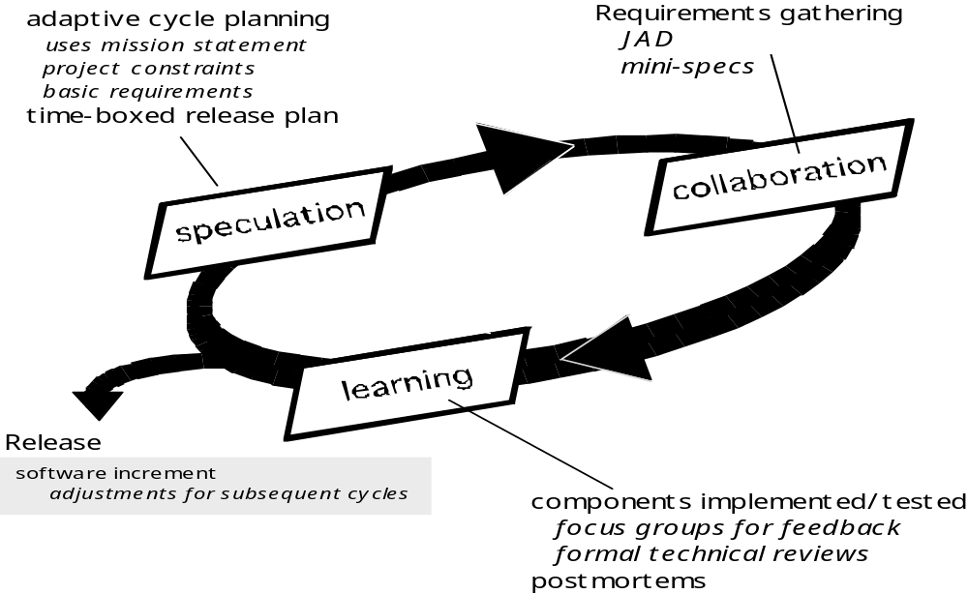
Adaptive Software Development
Agile Development

Slide 29
Dynamic Systems Development Method
Agile Development
Promoted by the DSDM Consortium (www.dsdm.org)
DSDM—distinguishing features
  Similar in most respects to XP and/or ASD
  Nine guiding principles
    Active user involvement is imperative.
    DSDM teams must be empowered to make decisions.
    The focus is on frequent delivery of products.
    Fitness for business purpose is the essential criterion for acceptance of deliverables.
    Iterative and incremental development is necessary to converge on an accurate business solution.
    All changes during development are reversible.
    Requirements are baselined at a high level
    Testing is integrated throughout the life-cycle.

Slide 30
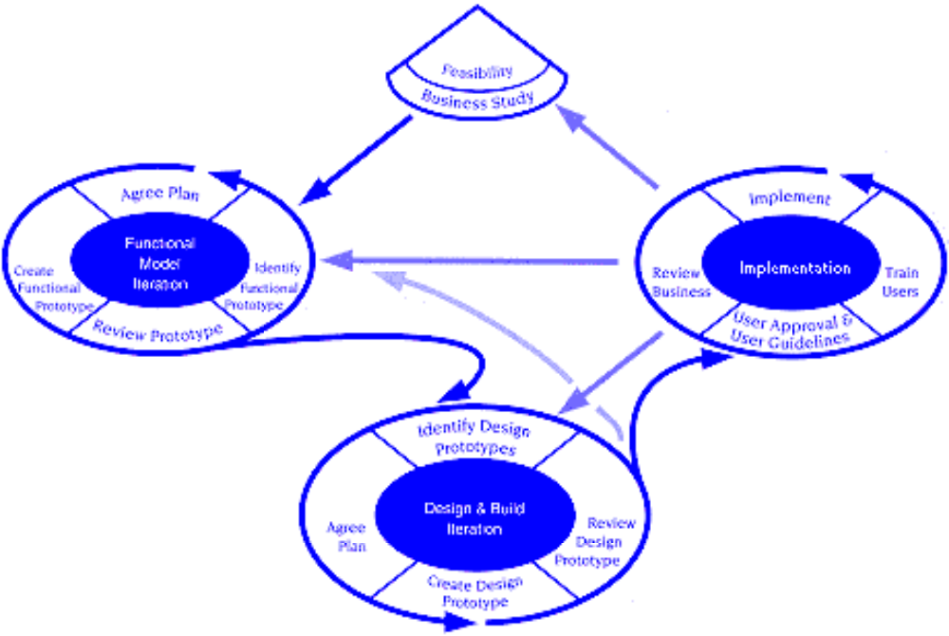
Dynamic Systems Development Method
Agile Development

Slide 31
Scrum
Agile Development
Originally proposed by Schwaber and Beedle
Scrum—distinguishing features
  Development work is partitioned into “packets”
  Testing and documentation are on-going as the product is constructed
  Work occurs in “sprints” and is derived from a “backlog” of existing requirements
  Meetings are very short and sometimes conducted without chairs
  “demos” are delivered to the customer with the time-box allocated

Slide 32
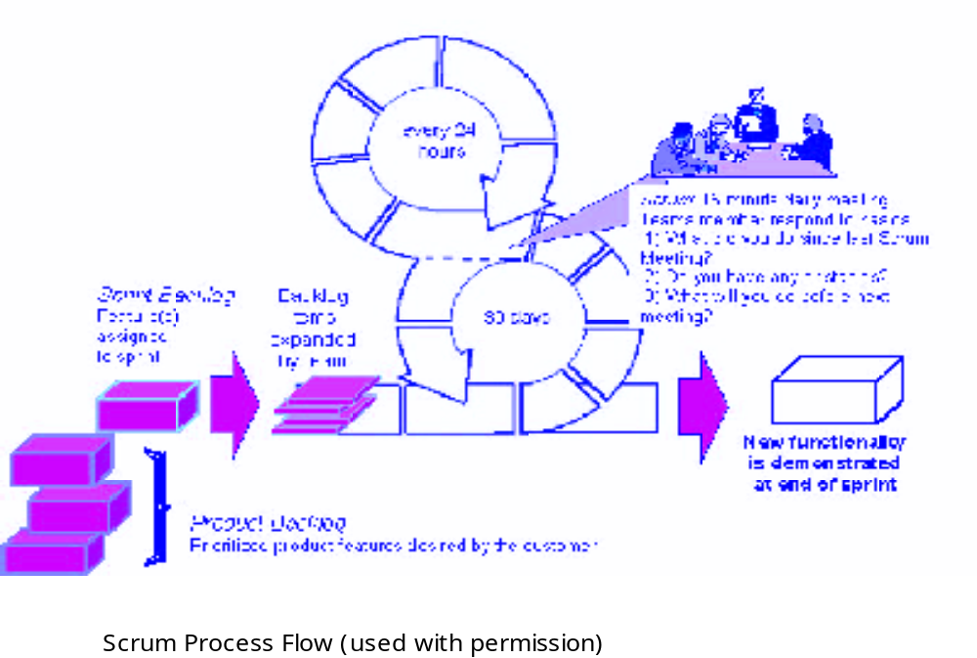
Scrum
Agile Development

Slide 33
Crystal
Agile Development
Proposed by Cockburn and Highsmith
Crystal—distinguishing features
  Actually a family of process models that allow “maneuverability” based on problem characteristics
  Face-to-face communication is emphasized
  Suggests the use of “reflection workshops” to review the work habits of the team

Slide 34
Feature Driven Development
Agile Development
Originally proposed by Peter Coad et al
FDD—distinguishing features
  Emphasis is on defining “features”
    a feature “is a client-valued function that can be implemented in two weeks or less.”
  Uses a feature template
    <action> the <result> <by | for | of | to> a(n) <object>
  A features list is created and “plan by feature” is conducted
  Design and construction merge in FDD

Slide 35
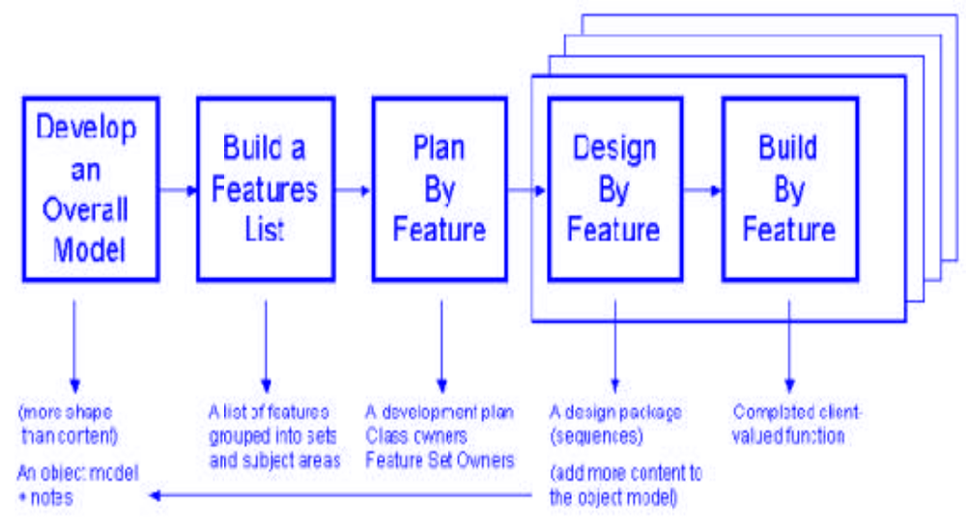
Feature Driven Development
Agile Development
Reprinted with permission of Peter Coad

Slide 36
Agile Modeling
Agile Development
Originally proposed by Scott Ambler
Suggests a set of agile modeling principles
  Model with a purpose
  Use multiple models
  Travel light
  Content is more important than representation
  Know the models and the tools you use to create them
  Adapt locally

Slide 37
HUMAN ASPECT OF SOFTWARE ENGINEERING

Slide 38
Characteristics of Software Engineer
Human Aspects of
Software Engineering
Erdogmus [erd09] identifies seven traits that are present when an individual software engineer exhibits “superprofesional” behavior.
An effective software engineer :
has a sense of individual responsibility
has an acute awareness
is brutally honest
exhibits resilience under prerssure
has a heightened sense of fairness
exhibits attention to detail
is pragmatic

Slide 39
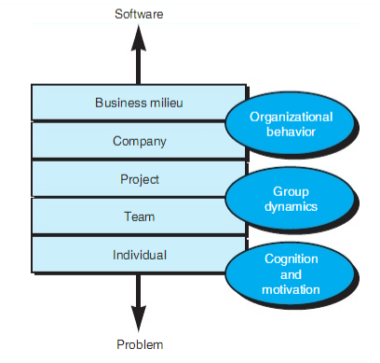
The Psychology of Software Engineering
Human Aspects of
Software Engineering
In a seminal paper on the psychology of software engineering, Bill curtis and Dave Walz [Cur90] suggest a layered behavioral model for software development.

Slide 40
Human Aspects of
Software Engineering
An effective team should foster a sense of trust
Software engineers on the team should trust the skills and competence of their peers and their managers.
The team should encourage a sense of improvement by periodically reflecting on its approach to software engineering and looking for ways to improve their work

Slide 41
Team Structure
Human Aspects of
Software Engineering
Constantine [Con93] suggests four “organizational paradigms” for software engineering teams
A closed paradigm; a team along a traditional hierarchy of authority
A random paradigm; a team loosely and depends on individual initiative of the team members
An open paradigm; a team in a manner that achieves some of the controls associated with the closed paradigm but also much of the innovation that occurs when using the random paradigm
A synchronous paradigm; relies on the natural compartmentalization of a problem and organizes team members to work on pieces of the problem with little active communication amonjg themselves

Slide 42
References
Pressman, R.S. (2015). Software Engineering : A Practioner's Approach. 8th ed. McGraw-Hill Companies.Inc, Americas, New York. ISBN : 978 1 259 253157.
Manifesto for Agile Software Development, http://agilemanifesto.org/
Multimedia : Video Water Fall, V model, http://www.youtube.com/watch?v=KaPC0gsEQ68
Software Engineering Incremental Model, http://www.youtube.com/watch?v=9cBkihYP1rY
The Strengths and Weaknesses of Extreme Programming, http://www.youtube.com/watch?v=LkhLZ7_KZ5w
Agile project management tutorial: What is agile project managemen, http://www.youtube.com/watch?v=MJR-EgHTA4E

Slide 43
Q & A

